Slide 1
Human Vision and Computer Vision

Slide 2

Visual Processing
What is it?
Where is it?
Is it moving?
Have I seen it before?

Slide 3
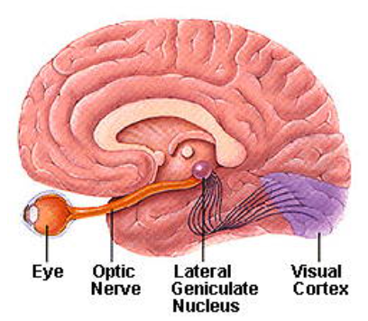
Visual Processing
Eye + brain = visual processing
Eye perceive stimuli but can’t understand
Brain can’t perceive visual stimuli but can process and learn

Slide 4
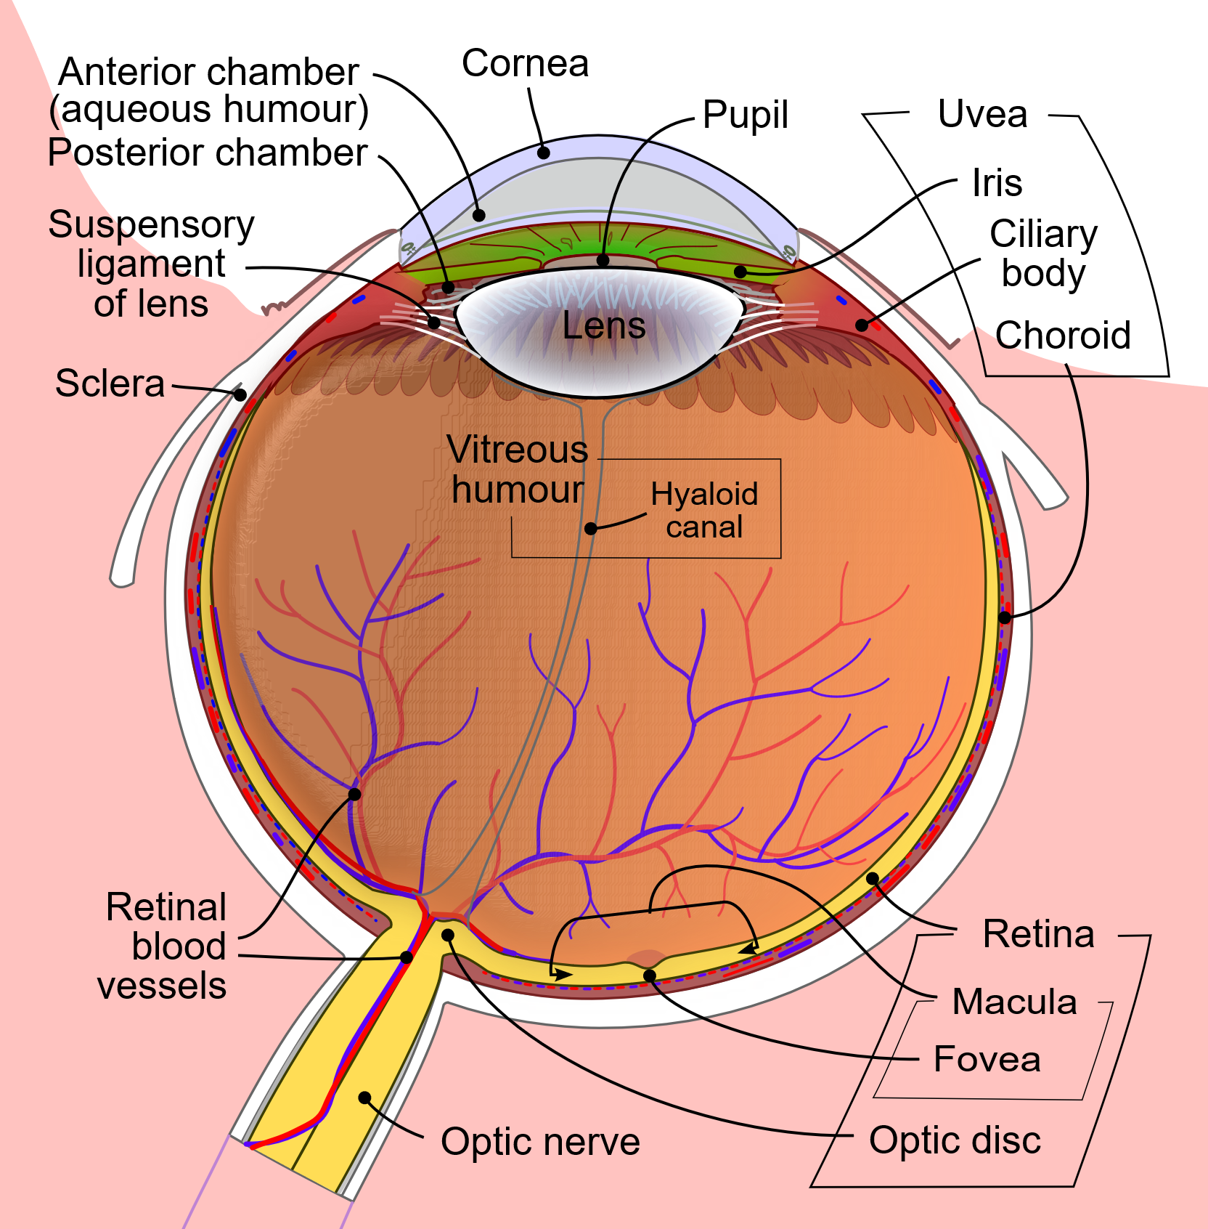
Hardware: The Eye
Cornea/lens focus; pupil controls light
Fovea = high acuity & color
Periphery = motion & low light
Blind spot where optic nerve exits
By Rhcastilhos. And Jmarchn. - Schematic_diagram_of_the_human_eye_with_English_annotations.svg, CC BY-SA 3.0, https://commons.wikimedia.org/w/index.php?curid=1597930
Notes:
Resolution isn’t uniform. We have a high-resolution ‘spotlight’ (fovea) and coarse periphery. We constantly move our eyes to stitch a detailed scene. This ‘foveation’ is a key design choice of biology.

Slide 5
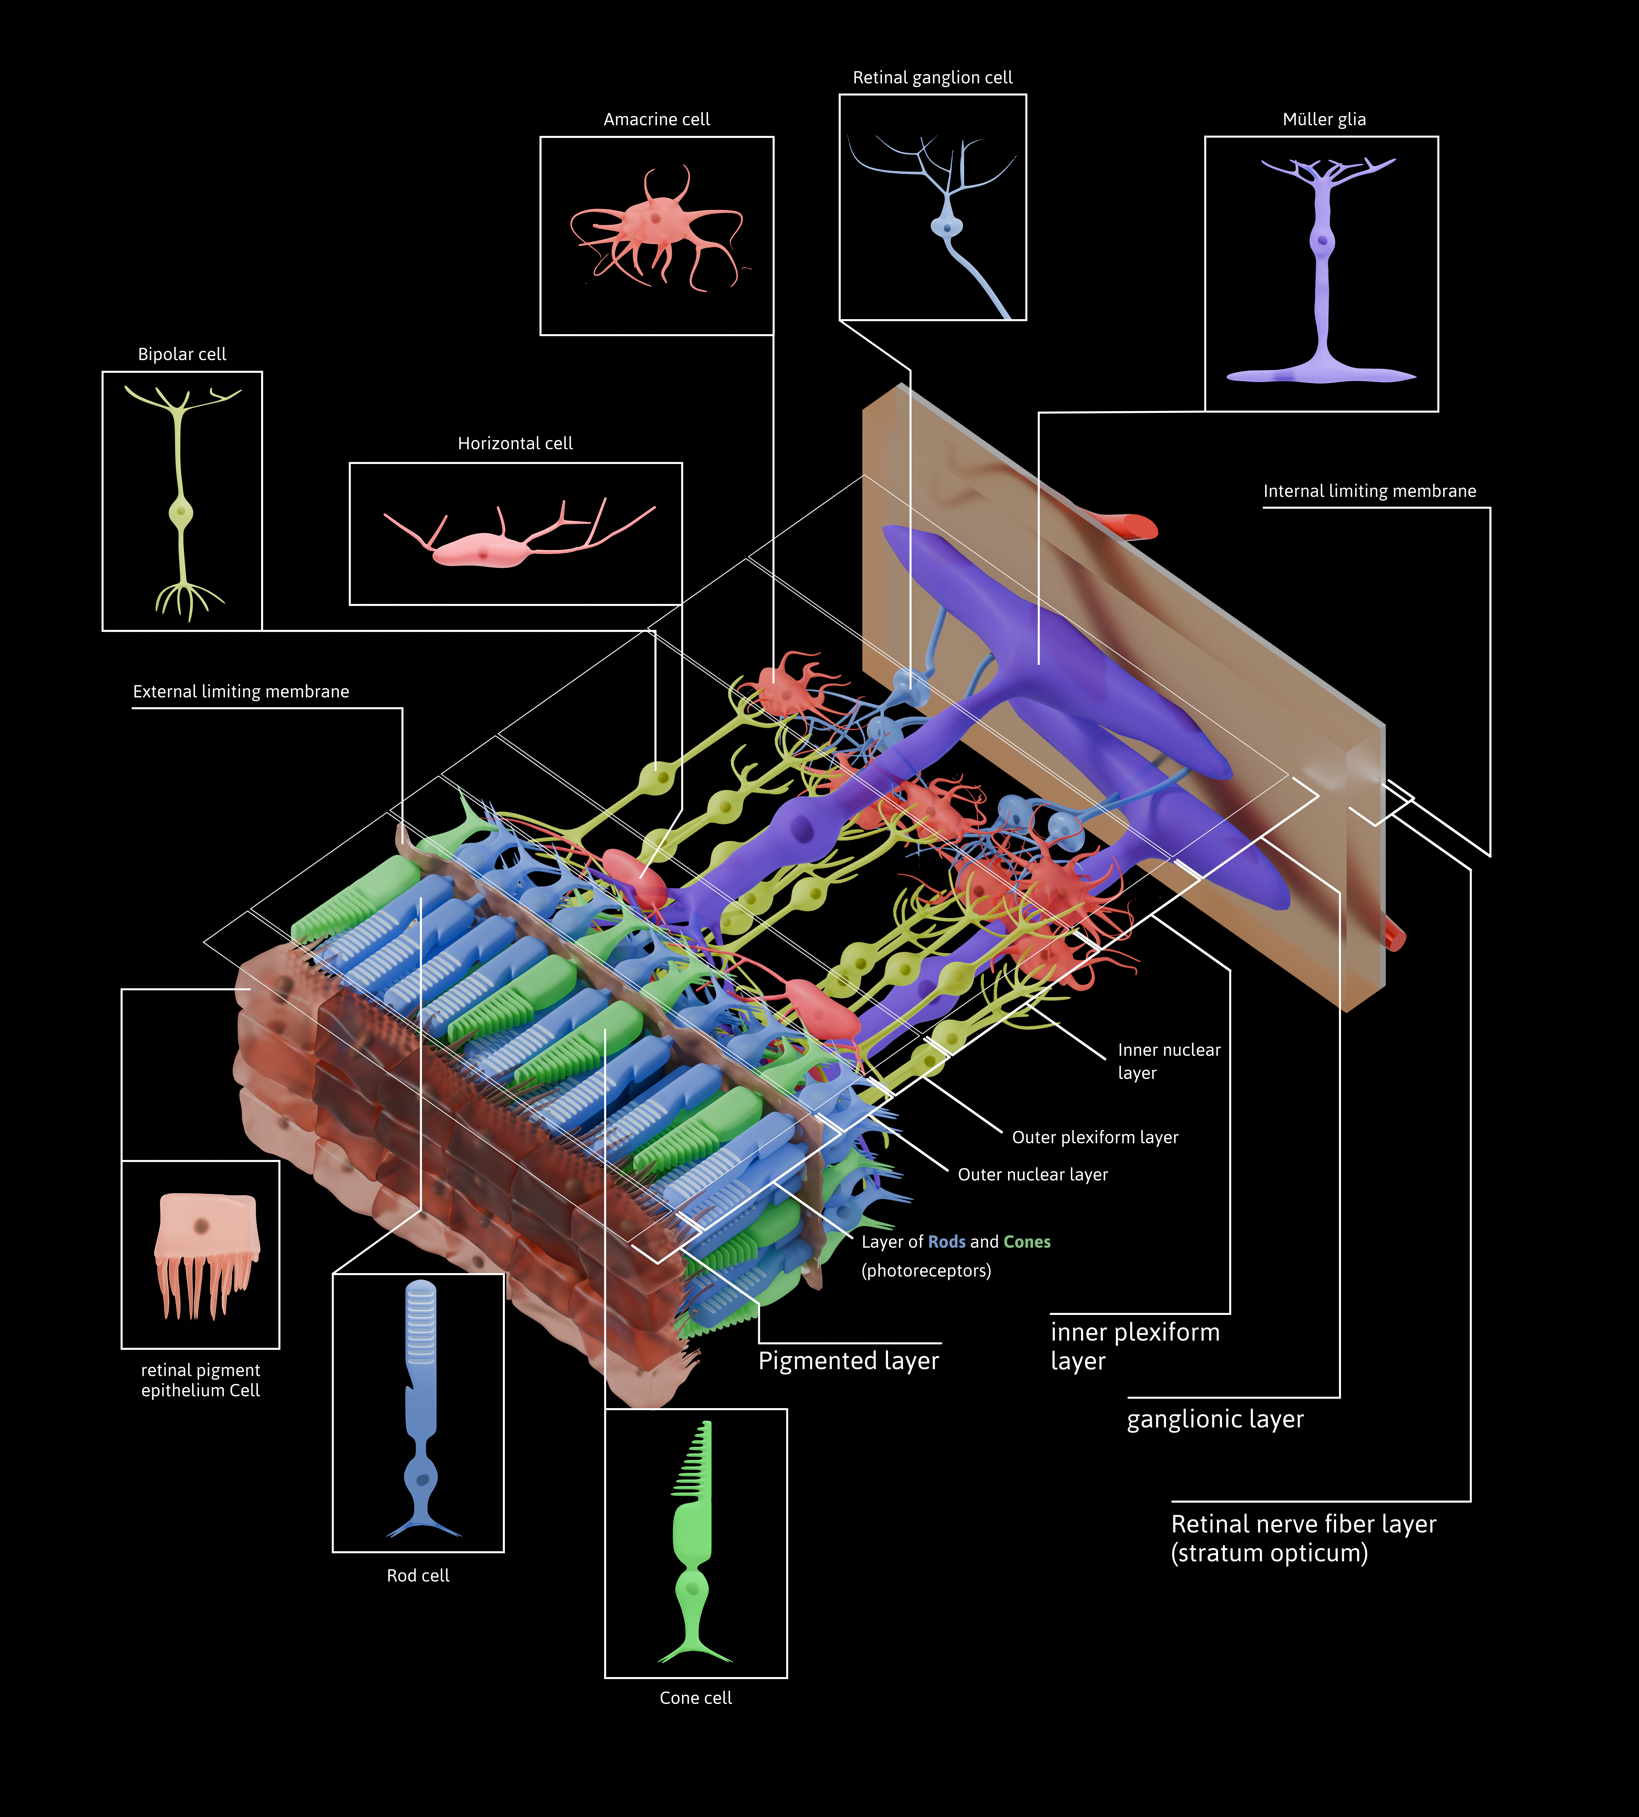
Pre-Processing: The Retina
[ Image placeholder: Center–surround kernel sketch + rod/cone distribution across retina ]
Convert light to neural signals and pre-process the image before it ever reaches the brain (contrast, edges, temporal changes).
By Otosakanum2 - Own work, CC BY-SA 4.0, https://commons.wikimedia.org/w/index.php?curid=174602486
Notes:
Before the brain sees anything, the retina extracts contrasts and edges. Ganglion cells respond to differences, not absolute brightness. That’s why edges and changes pop out—and why many illusions target contrast assumptions.

Slide 6
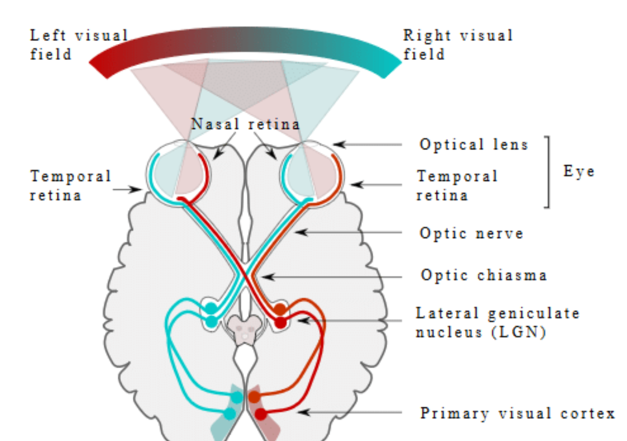
Visual Magic
Depth from hints: Stereo (two eyes), parallax (move your head), perspective (lines converge), shading (light & shadow).
Motion pops: We notice change; the periphery is great at detecting movement.
Selective seeing: Fast eye jumps (saccades) + attention decide what gets processed → change blindness happens.
Notes:
Fundus photograph of the retina including the macula (dark spot in the middle) and optic nerve (light circle to the left)

Slide 7
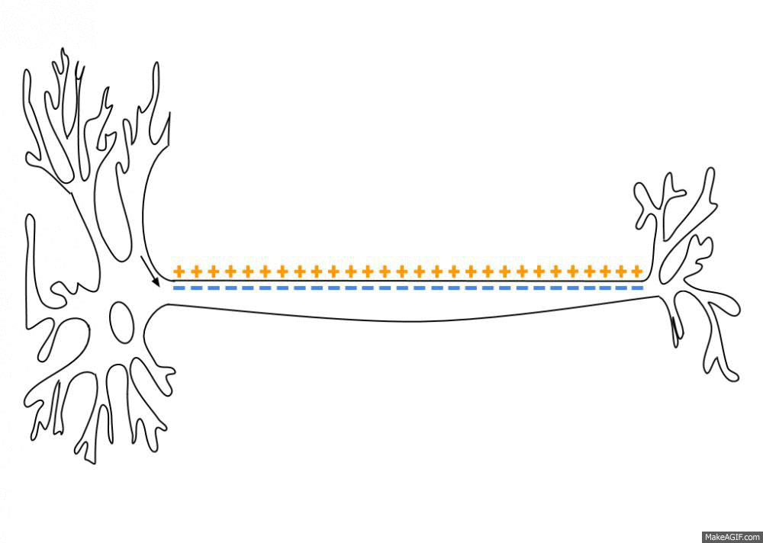
Visual Neurons
Fire action potentials when visual stimuli appear in their receptive field
Certain neurons respond best to specific stimuli (neuronal tuning)
In the earlier visual areas, neurons have simpler tuning.
By Laurentaylorj - Own work, CC BY-SA 3.0, https://commons.wikimedia.org/w/index.php?curid=26311114
Notes:
V1 neurons act like oriented edge detectors at different scales—very much like applying banks of filters. The layout preserves the image’s geometry (retinotopy), enabling the brain to build contours and shapes.

Slide 8
How the Brain Builds Recognition
The brain builds a picture in layers:
Edges
Parts
Objects
Corrects for lighting (color/brightness constancy).
Makes a quick first guess then refines based on data and expectations
Notes:
The brain builds a picture in layers. It makes a quick first guess, then uses attention and what you expect to see to refine it. Because info moves both up and down, context can change what you perceive.”

Slide 9


Edges – First Visual Cortex
V1
Keeps a neat map of the scene
Detects edges at different angles and sizes
Passes this info to V2 for more complex patterns.
In the occipital lobe
Notes:
V1 neurons act like oriented edge detectors at different scales—very much like applying banks of filters. The layout preserves the image’s geometry (retinotopy), enabling the brain to build contours and shapes.

Slide 10
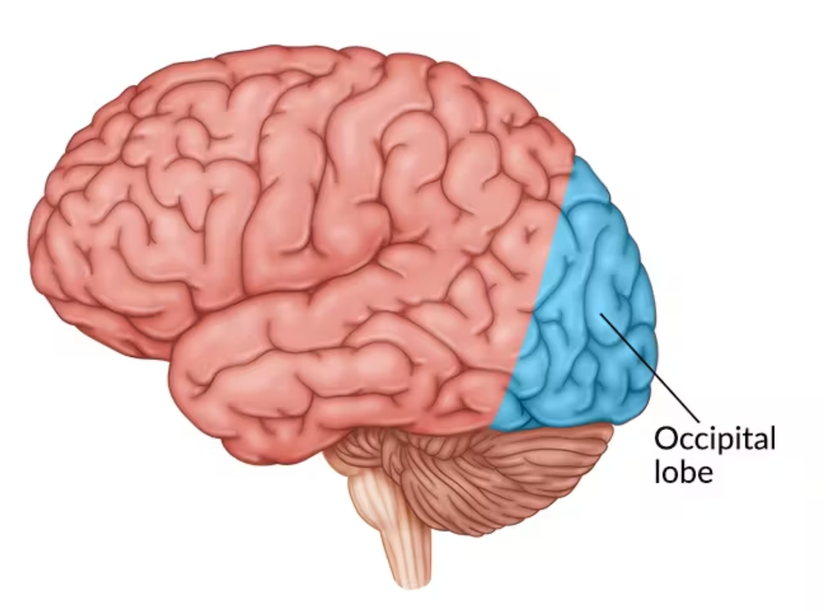
Edges – First Visual Cortex
Notes:
V1 neurons act like oriented edge detectors at different scales—very much like applying banks of filters. The layout preserves the image’s geometry (retinotopy), enabling the brain to build contours and shapes.

Slide 11
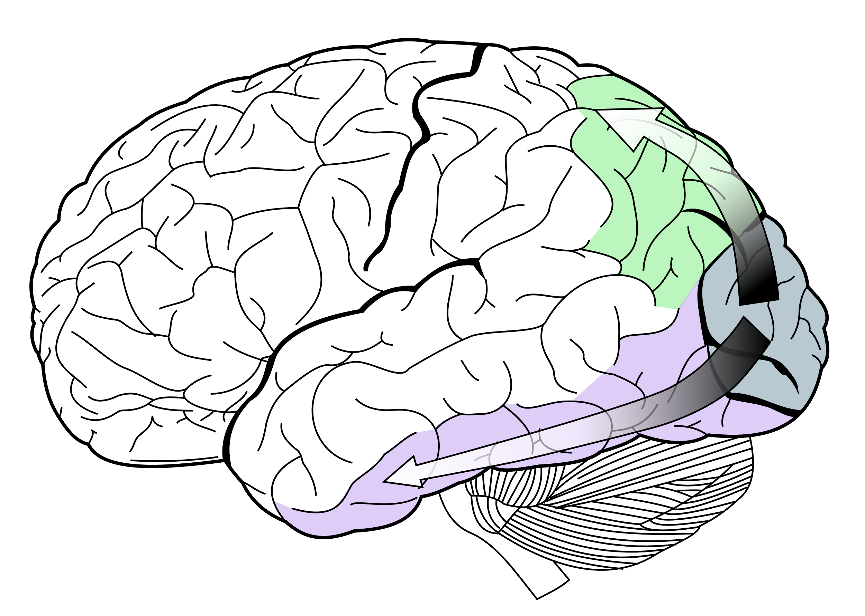
Parts – The Ventral/“What” Pathway
V2, V3, V4 (ventral stream) and lateral occipital complex
V2: groups edges into contours
Ventral Stream

Slide 12
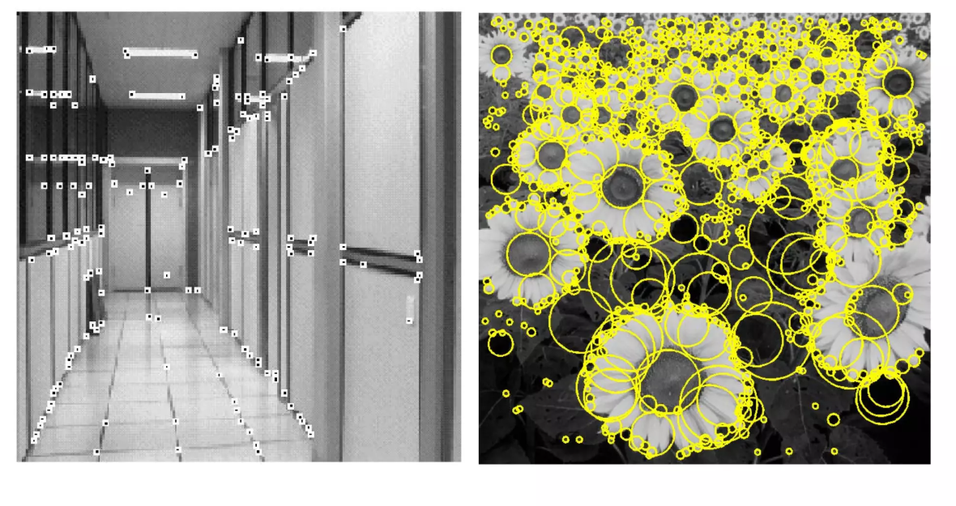
Parts – The Ventral/“What” Pathway
V4: tuned to curvature, corners, shape fragments, and integrates color/texture into surface patches.
Associated with storage of long-term memory

Slide 13
The “Where/How” Pathway
Dorsal Stream
Dorsomedial area and middle temporal area (MT/V5) and to posterior parietal cortex
Associated with motion, representation of object locations, and control of the eyes and arms, especially when visual information is used to guide reaching.
Dorsal Stream
By Selket - I (Selket) made this from File:Gray728.svg, CC BY-SA 3.0, https://commons.wikimedia.org/w/index.php?curid=1679336

Slide 14
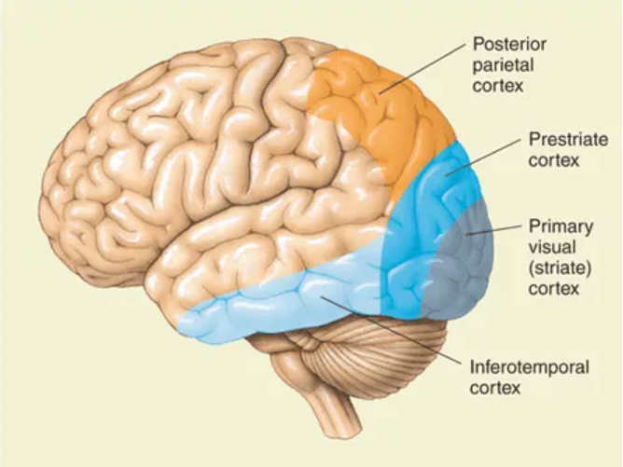
Objects – Inferotemporal Cortex
Specialized patches for recognizing faces, places and bodies
Build object-centered representations that are relatively invariant to size, position, and viewpoint.
Support category membership (“this is a dog”) and individual identity (this particular dog).

Slide 15

It’s a Jigglypuff!

Slide 16
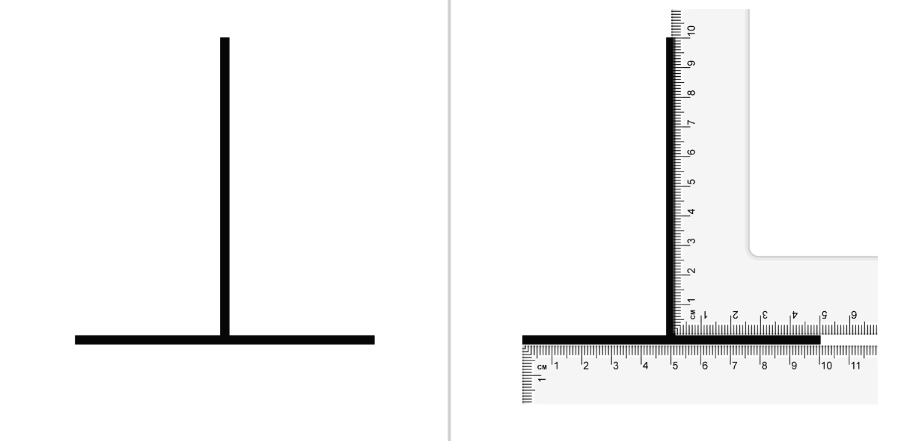
Optical illusions
Illusions show vision is inference, not a camera
By S-kay - Own work, Public Domain, https://commons.wikimedia.org/w/index.php?curid=8845534
Notes:
Your brain guesses the world from limited, noisy input. Illusions prove we do interpretation, not raw recording. We’ll tour the human pipeline from optics to perception—and set up parallels to computer vision later.

Slide 17
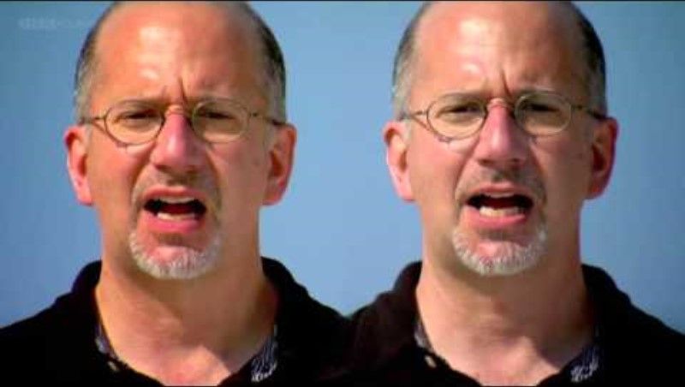
The McGurk Effect

Slide 18

Sensory Hallucination

Slide 19
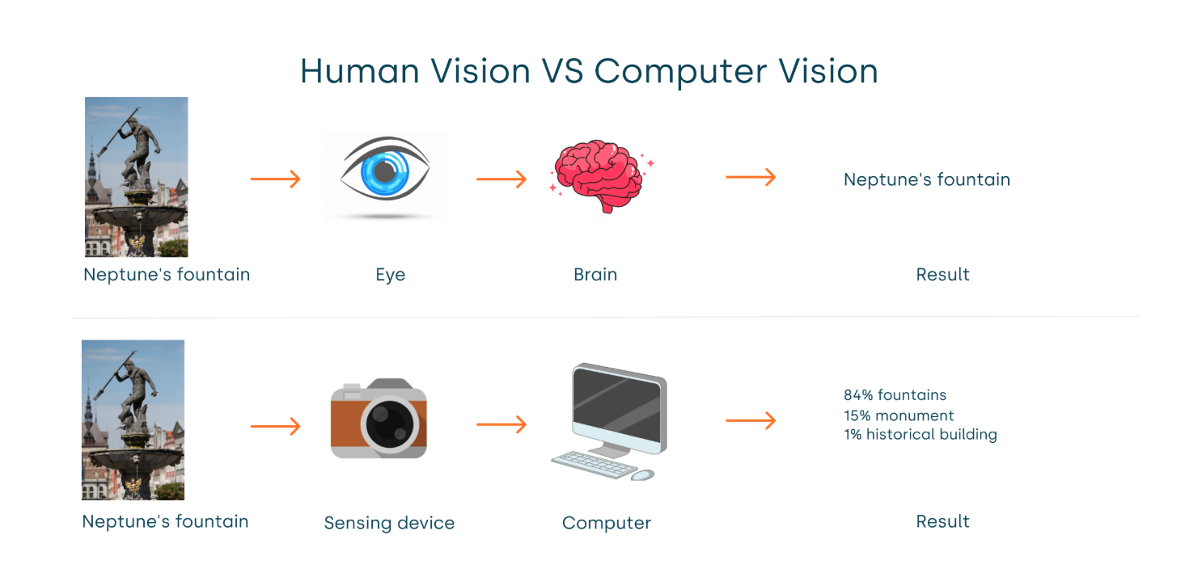
Human vs. Computer Vision

Slide 20
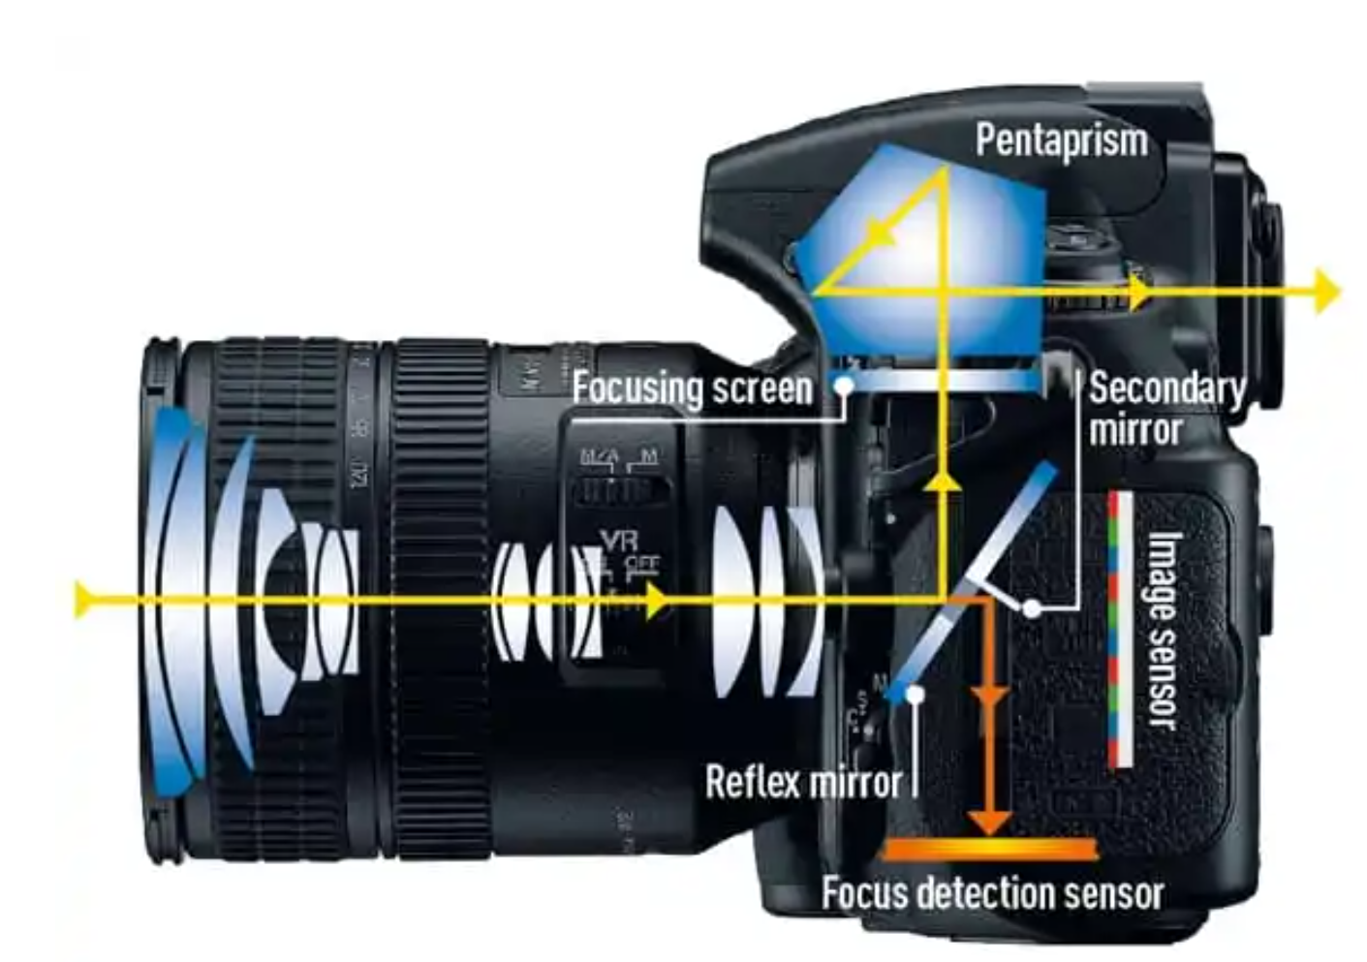
How Cameras Capture an Image
Lens focuses light and aperture controls how much light enters.
Similar to human lens, cornea and iris
Notes:
Photons arrive at a pixel cell’s photodiode.
The photodiode converts photons → electrons (charge) and accumulates them during the exposure (the “bucket” idea).
After exposure, electronics measure the accumulated charge (like a light meter reading), convert it to a voltage, then an ADC turns it into a number (the pixel value).

Slide 21
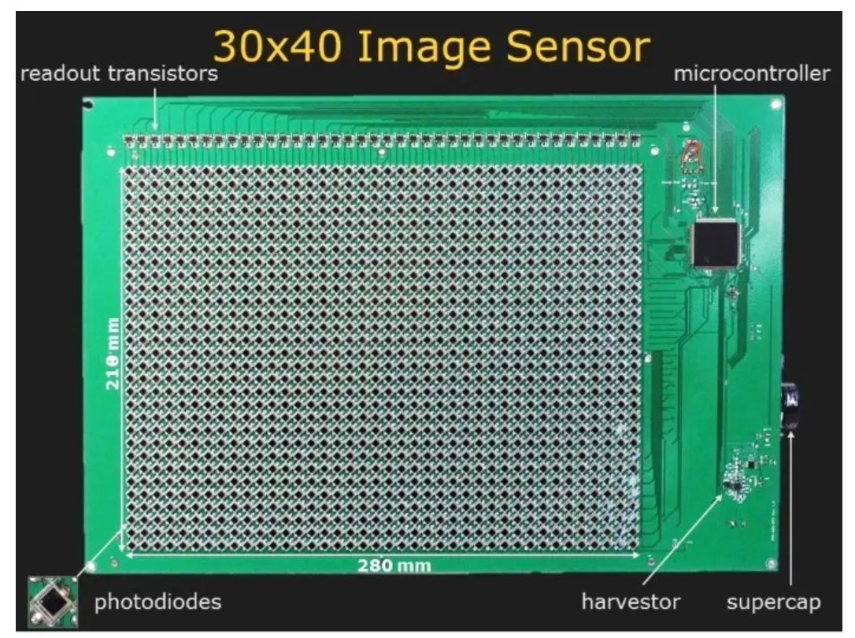
How Cameras Capture an Image
Photons of light arrive at each of the camera’s millions of pixel cell photodiodes
The photodiode turns the light into electrical charge and accumulates them during exposure
The camera measures the charge and stores the result as a number called the pixel value
Notes:
Photons arrive at a pixel cell’s photodiode.
The photodiode converts photons → electrons (charge) and accumulates them during the exposure (the “bucket” idea).
After exposure, electronics measure the accumulated charge (like a light meter reading), convert it to a voltage, then an ADC turns it into a number (the pixel value).

Slide 22
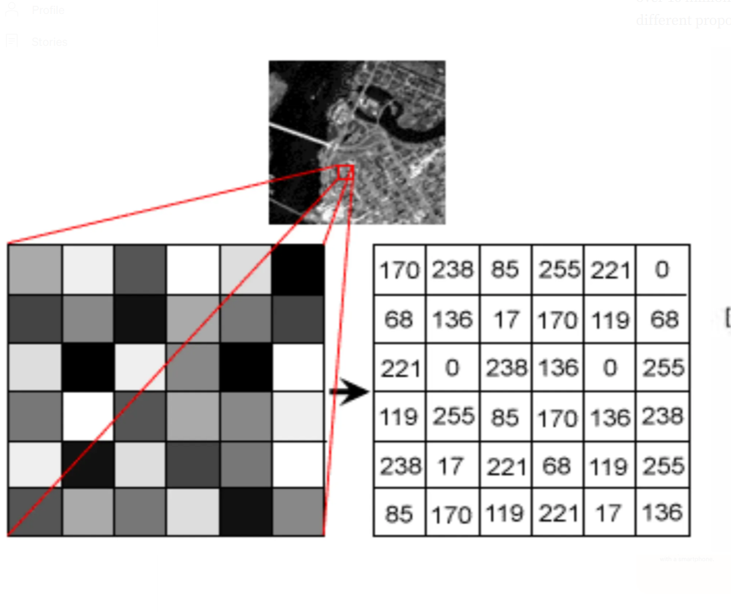
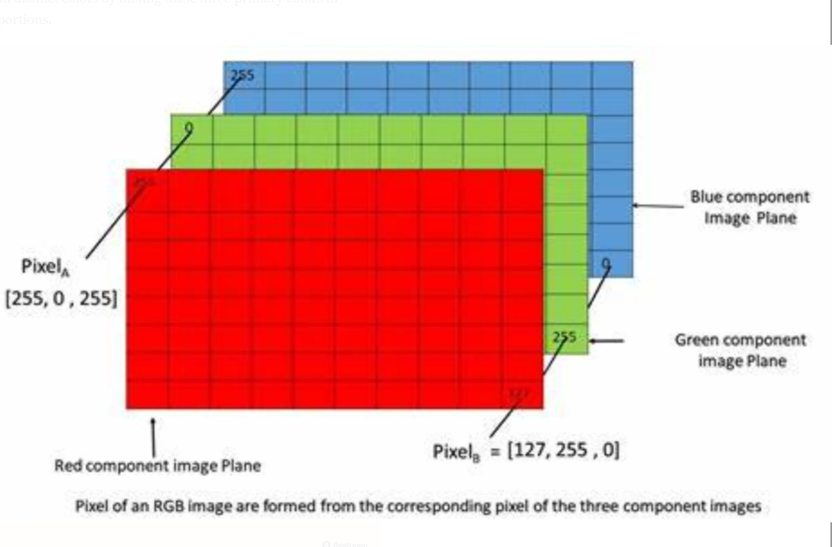
Digital Images
A digital image is a grid of tiny squares called pixels.
Example: 1920 × 1080 ≈ 2.07 million pixels (≈2 MP).
Each pixel stores numbers.
Grayscale: 1 number per pixel (0 = black … 255 = white).
Color (RGB): 3 numbers per pixel (R, G, B).

Slide 23

How do we get color images?
When white light passes through a prism, it separates into a spectrum of colors, like a rainbow, a phenomenon called dispersion

Slide 24
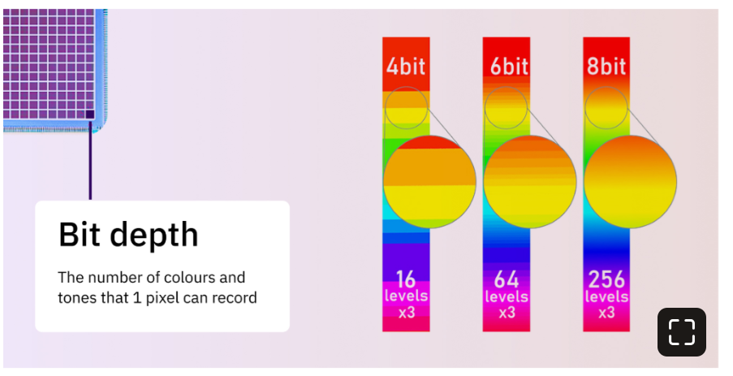
Digital Images
More pixels ≈ more detail (until the lens, focus, or noise becomes the limit).

Slide 25
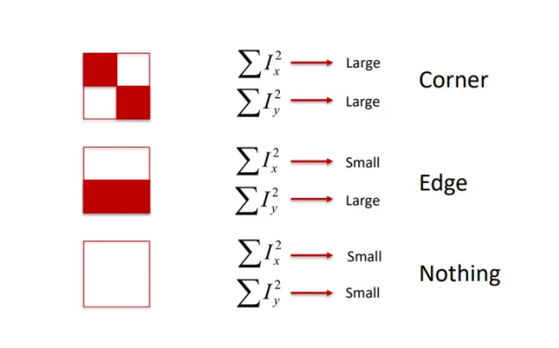
Pixels to Patterns
Computers operate on larger pattens, not individual pixels
Edges: big differences between neighbors
Corners: Edges meeting
Blobs: Roundish contrast

Slide 26
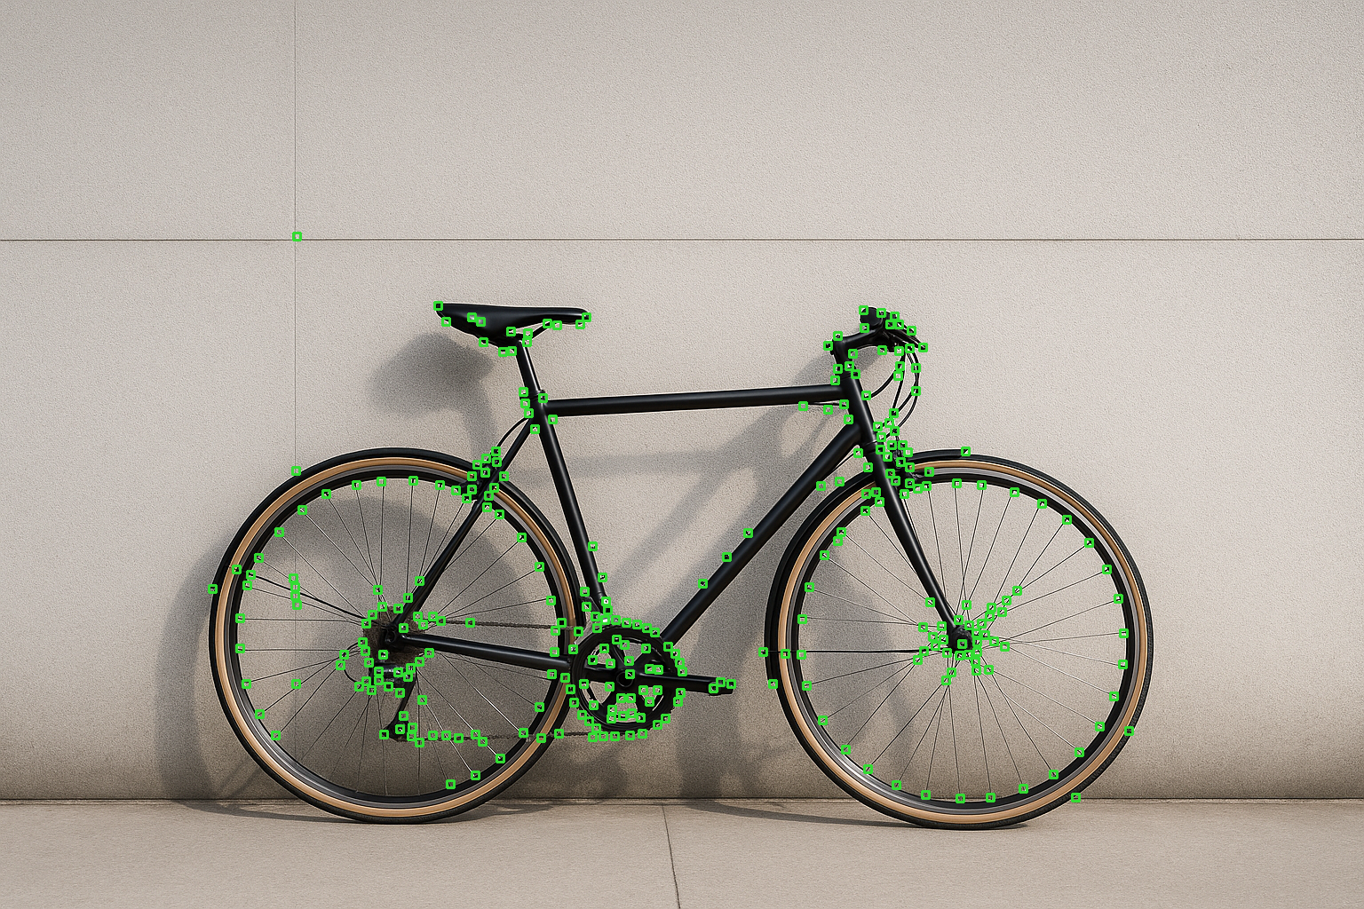
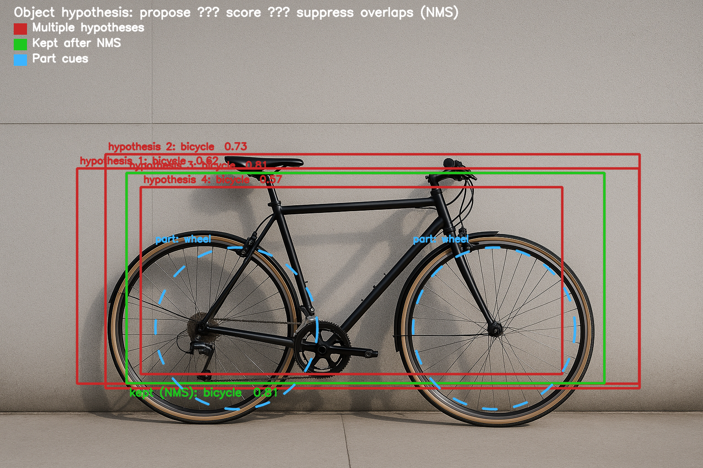
Building Up an Image
Group edges, corners, and blobs into small regions
Make guesses about parts and objects
Combine clues across the image
Check ourselves by counting correct finds and mistakes
Notes:
After we find edges, corners, and blobs, we group them into small regions and write a quick description of each. From these, we make guesses about parts and objects, then search across positions and sizes so small and large objects are treated fairly. We combine clues—shapes, colors, and how parts line up—and keep only confident results while removing duplicates. Finally, we check ourselves by counting correct finds and mistakes. That’s the core idea of classic computer vision before deep learning—and the same logic (propose, score, refine) keeps showing up even in modern systems.”

Slide 27
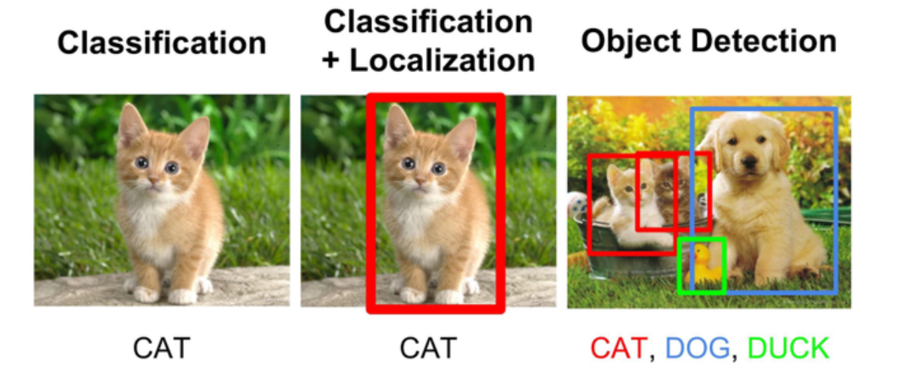
Computer Vision Applications
.
Image classification: one label for the whole image
Object detection: boxes + labels around each object
Segmentation: which pixels belong to the object
Motion/change detection: what moved between frames
Tracking: follow the same object over time

Slide 28
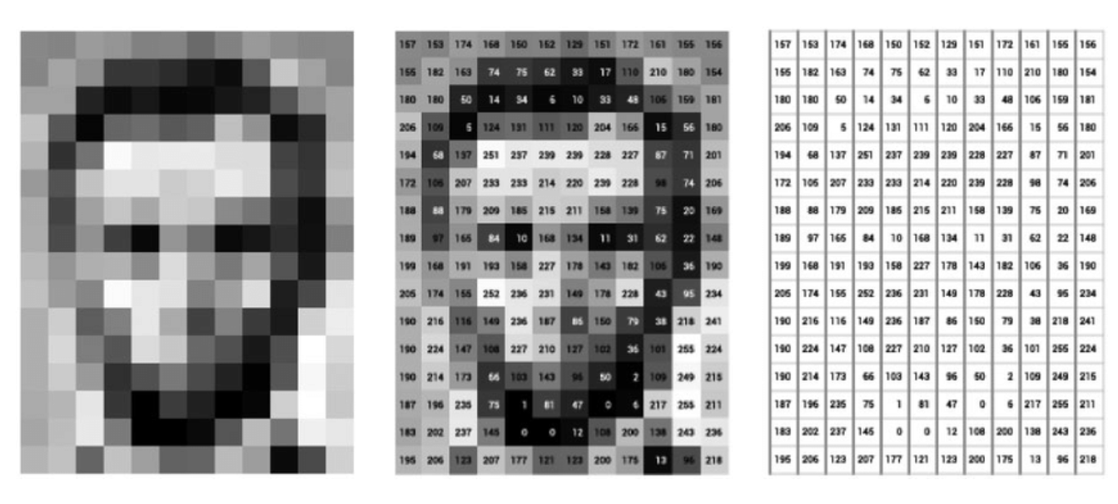
Next time…
Image preprocessing

Slide 29
The Retina: Key Cell Types
[ Image placeholder: Center–surround kernel sketch + rod/cone distribution across retina ]
Photoreceptors:
Rods
Very light-sensitive
No color
Dominate the periphery
Night vision
Cones
Color
Fine detail
Daylight vision
By Otosakanum2 - Own work, CC BY-SA 4.0, https://commons.wikimedia.org/w/index.php?curid=174602486
Notes:
Before the brain sees anything, the retina extracts contrasts and edges. Ganglion cells respond to differences, not absolute brightness. That’s why edges and changes pop out—and why many illusions target contrast assumptions.

Slide 30
The Retina: Key Cell Types
[ Image placeholder: Center–surround kernel sketch + rod/cone distribution across retina ]
Amacrine cells
Inside the retina
Tune the message
Sharpen “on vs. off,”
Emphasize motion and shape timing
Ganglion cells
Send the final, edited message to the brain
Long fibers bundle together as the optic nerve
Report features like edges, color, and motion.
Notes:
Amacrine cells = editors. They stay inside the retina and tune the message: sharpen “on vs. off,” emphasize motion, and shape timing. They don’t send signals out of the eye—they just refine them.
Ganglion cells = messengers. They send the final, edited message to the brain. Their long fibers bundle together as the optic nerve and report features like edges, color, and motion.
One-liner: amacrine cells tune, ganglion cells transmit.
Quick analogy: like a newsroom—amacrines are the copy editors who polish the story; ganglion cells are the reporters who file the story to the brain.

Slide 31
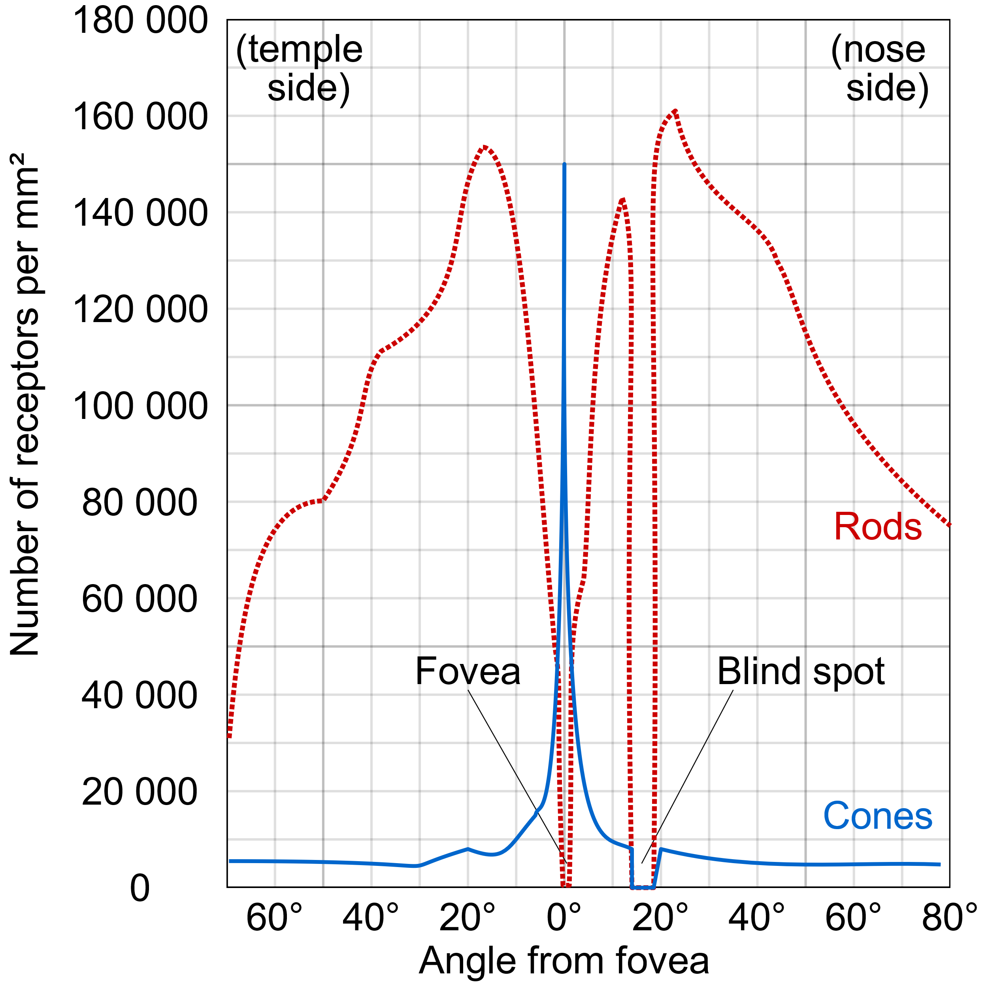
The Retina: Macula and Fovea
Macula
High-acuity
Color-rich central vision
Used for reading, face recognition, and fine inspection
Fovea
Absolute peak spatial resolution and color discrimination under bright light
By Cmglee - Own work, CC BY-SA 3.0, https://commons.wikimedia.org/w/index.php?curid=29924570

